Slide 1

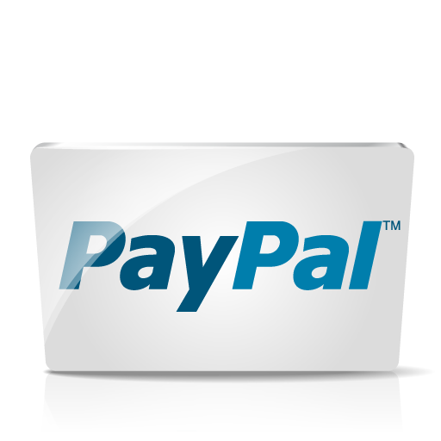

Why PayPal?
Security
Powerful API
Integration Support

